Slide 1
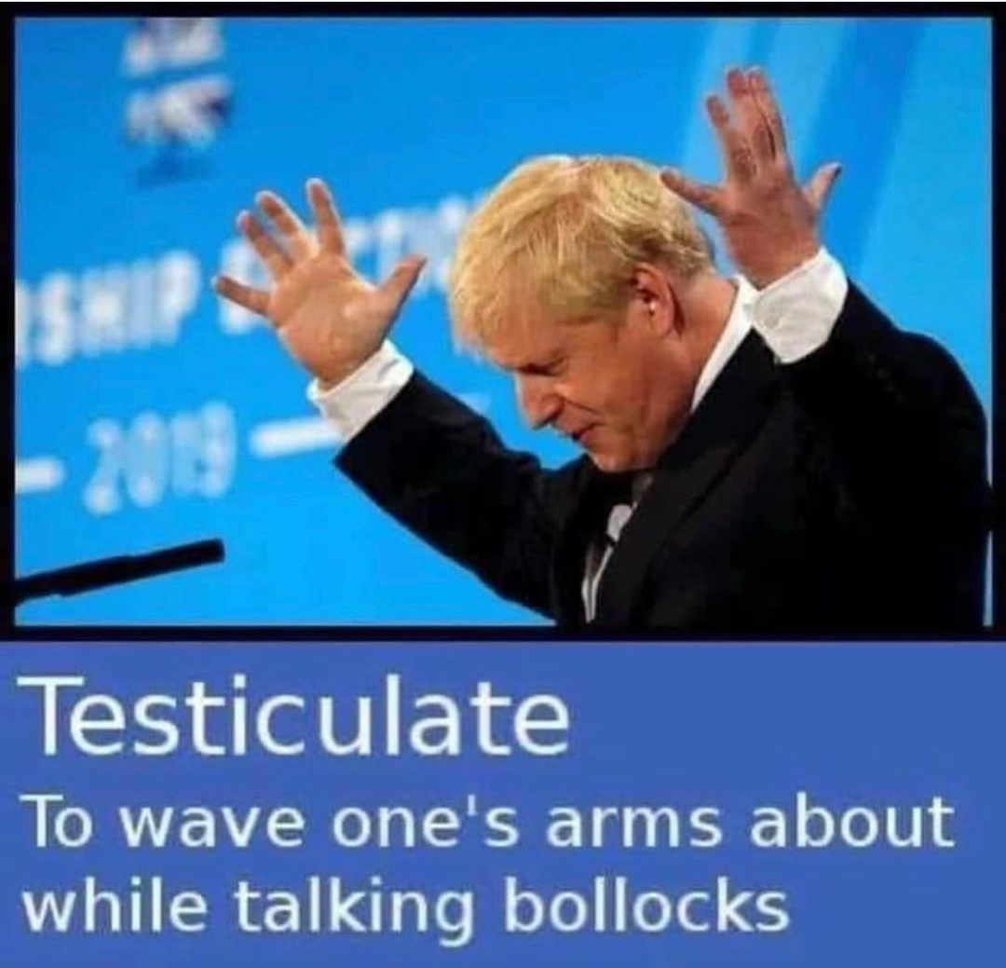
Phoenix Christmas Quiz

Slide 2
Round 1
Multi Choice

Slide 3
Question 1
10% of Americans think it is acceptable to start drinking at what time.
10 AM or earlier
noon or earlier
2pm or later
6pm or later

Slide 4
Question 2
Pteronophobia is the fear of what;
Flying lizards
Canada
Feathers
The dark

Slide 5
Question 3
More than what percentage of the world's population consumes caffeine on a daily basis.
30%
50%
70%
90%

Slide 6
Question 4
New Zealand has the ability to block certain baby names if they’re considered offensive. Which one of these is a rejected name?
Violence
Number 16 Bus Shelter
Twins called Fish and Chips
Twins called Benson and Hedges

Slide 7
Question 5
How long was the world’s longest recorded fart?
(Nearest answer wins)

Slide 8
Question 6
A Russian book on etiquette from 1889 suggested that women should avoid what?
Shouting
Talking to your neighbours husband
Unpleasant language
Puns

Slide 9
Question 7
Which primates have the largest average size of penises.
Gorilla
Human
Orangutan
Chimpanzee

Slide 10
Question 8
In ‘The Art of Farting’ (1751), Pierre-Thomas Hurtault gave a classification of farts that included 3 of the following. Which one is false
Silent but smelly
Soft and sudden
Bourgeois women
Geographers

Slide 11
Question 9
If you received x amount dollars for every year that the universe has existed, you would have approximately as much money as Jeff Bezos.
$1
$10
$100
$1000

Slide 12
Question 10
The first sport to resume after the UK’s Coronavirus lockdown was eased was;
competitive pigeon racing
golf
tennis
snooker

Slide 13
Round 2
True or False

Slide 14
Question 11
True or False?
In Texas it is illegal to change the weather

Slide 15
Question 12
True or False?
In the USA it is illegal for more than 2 people to gather in public wearing masks.

Slide 16
Question 13
True or False?
There is an ancient Egyptian frieze in The Temple of Seti that appears to show a helicopter, an aeroplane and a submarine

Slide 17
Question 14
True or False?
According to a 2014 survey, Scottish men are sexier and better lovers than English men

Slide 18
Question 15
True or False?
Humans glow in the dark

Slide 19
Question 16
True or False?
The American state of New Hampshire has legalised flying cars

Slide 20
Question 17
True or False?
The Swedish word GÖKOTTA means to wake up early in the morning in order to go outside and hear the first birds sing

Slide 21
Question 18
True or False?
Among the Yoruba-speaking population of Nigeria, “Man United” is slang for “idiot”.

Slide 22
Question 19
True or False?
Every Dutch police car is equipped with a teddy bear to give children that are scared

Slide 23
Question 20
True or False?
It is illegal to own a rabbit in Queensland, Australia unless you can prove you are a practicing magician.

Slide 24
Round 3
Misc.

Slide 25
Question 21
True or false,
The Beatles wanted to make a Lord of the Rings film with John Lennon as Golum.

Slide 26
Question 22
Monks in the Khun Han district of Thailand were frustrated with littering in their district, so they did what with the litter?

Slide 27
Question 23
Something that is known as the ‘Lloyds Bank Coprolite’ was left behind by the Vikings. It was found in York where a branch of Lloyds Bank now stands. What is it?

Slide 28
Question 24
Dr Seuss' publisher bet him $50 that he could not write a book using only 50 words. Did he win the bet?

Slide 29
Question 25
When was Christmas invented?

Slide 30
Question 26
What music album was so popular in Poland that the nation exhausted its entire supply of foreign currency buying it?
I can give a clue of the year.

Slide 31
Question 27
When a tattoo is laser-removed, what happens to the ink?

Slide 32
Question 28
The Icelandic word ‘vasa’ means pocket.
What famous 1980’s product was given the Icelandic name ‘vasadiskó’.

Slide 33
Question 29
Name something often found in the bottom of bird cages _ _ IT

Slide 34
Question 30
What's red and smells and is often picked in the garden _ OSE

Slide 35
Round 4
Any other business

Slide 36
Question 31
The day recreational marijuana was legalised in a Canada, a 9 year old girl scout in Edmonton did what outside a newly opened weed shop?

Slide 37
Question 32
The first line of CONPLANN 8888, the US government’s strategy for defending against zombies, states what?

Slide 38
Question 33
What is the pope not allowed to do with his body?

Slide 39
Question 34
True or False?
Women fall in love more times in their lifetime than men do.

Slide 40
Question 35
Your cat is more likely to like you if what?

Slide 41
Question 36
True or False?
Fear that you are being haunted is called Casper syndrome.

Slide 42
Question 37
In 2011, The Chambers Dictionary defined what as 'a cake, long in shape but short in duration‘?

Slide 43
Question 38
During the 1980s how many different singles took the UK chart number 1 spot?

Slide 44
Question 39
Which is the most visited country in the world?

Slide 45
Question 40
Mahnà Mahnà, the song made famous by The Muppets, was originally composed for;
Sesame Street
The James Brown band The Furious Five
The film Animal House
An X-rated Italian film

Slide 46
That’s the end of the quiz

